Slide 1
Instructor: Lilian de Greef Quarter: Summer 2017
CSE 373: Data Structures and Algorithms
Lecture 9: Binary Search Trees

Slide 2
Today
Announcements
Binary Trees
Height
Traversals
Binary Search Trees
Definition
find
insert
delete
buildTree

Slide 3
Announcements
Change to office hours for just this week
Tuesday’s “office” office hours / private office hours
12:00pm – 12:30pm
(not at 1:30pm!)
Dorothy and I trading 2:00pm - 3:00pm office hours this week
Same time and location
Homework 1 Statistics
Mean: 39.7/50 (+1 extra credit)
Median: 42.5/50 (+0 extra credit)
Max: 49/50 (+1) or 47/50 (+4)
Standard Deviation: 10.18

Slide 4
Reminder: Tree terminology
Node / Vertex
A
Root
B
C
Left subtree
Right subtree
D
E
F
G
Edges
H
I
Leaves
J
K
L
M
N

Slide 5
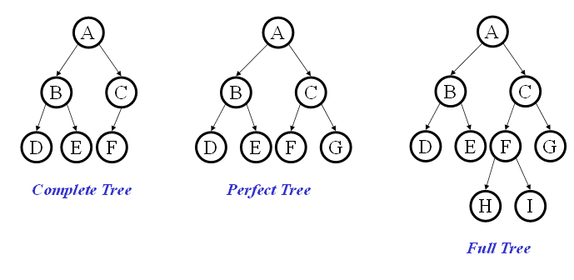
Binary Trees
Binary tree: Each node has at most 2 children (branching factor 2)
Binary tree is
A root (with data)
A left subtree (may be empty)
A right subtree (may be empty)
Special Cases:

Slide 6
(Last week’s practice) What does the following method do?
int height(Node root){
if (root == null),
return -1;
return 1 + max(height(root.left),
height(root.right);
}
It calculates the number of nodes in the tree.
It calculates the depth of the nodes.
It calculates the height of the tree.
It calculates the number of leaves in the tree.

Slide 7
Binary Trees: Some Numbers
Recall: height of a tree = longest path from root to leaf (count edges)
For binary tree of height h:
max # of leaves:
max # of nodes:
min # of leaves:
min # of nodes:
For n nodes, the min height (best-case) is
the max height (worst-case) is

Slide 8
Tree Traversals
A traversal is an order for visiting all the nodes of a tree
Pre-order: root, left subtree, right subtree
In-order: left subtree, root, right subtree
Post-order: left subtree, right subtree, root
A
B
C
D
E
F
G

Slide 9
Tree Traversals: Practice
Which one makes sense for evaluating this expression tree?
Pre-order: root, left subtree, right subtree
In-order: left subtree, root, right subtree
Post-order: left subtree, right subtree, root
+
*
5
2
4

Slide 10
Binary Search Tree (BST) Data Structure
Structure property (binary tree)
Each node has ≤ 2 children
Result: keeps operations simple
Order property
Result: straight-forward to find any given value
8
5
11
2
6
10
12
4
7
9
14
13
A binary search tree is a type of binary tree
(but not all binary trees are binary search trees!)

Slide 11
Practice: are these BSTs?
5
8
4
8
5
11
1
7
11
2
7
6
10
18
All children must obey order
3
4
15
20
21

Slide 12
How do we find(value) in BST’s?
12
5
15
2
9
20
7
10
17
30

Slide 13
find in BST: Recursive Version
Data find(Data value, Node root){
if(root == null)
return null;
if(key < root.value)
return find(value, root.left);
if(key > root.value)
return find(value, root.right);
return root.value;
}
12
5
15
2
9
20
What is the running time?
7
10
17
30

Slide 14
find in BST: Iterative Version
12
Data find(Object value, Node root){
while(root != null
&& root.value != value) {
if (value < root.value)
root = root.left;
else (value > root.value)
root = root.right;
}
if(root == null)
return null;
return root.value;
}
5
15
2
9
20
7
10
17
30

Slide 15
Other BST “Finding” Operations
findMin: Find minimum node
findMax: Find maximum node
12
5
15
2
9
20
7
10
17
30

Slide 16
insert in BST
12
insert(13)
insert(8)
insert(31)
Worst-case running time:
5
15
2
9
20
7
10
17
30

Slide 17
Practice with insert, primer for delete
Start with an empty tree. Insert the following values, in the given order:
14, 2, 5, 20, 42, 1, 4, 16
Then, changing as few nodes as possible, delete the following in order:
42, 14
What would the root of the resulting tree be?
2
4
5
16

Slide 18
(Extra space for scratch work / notes)

Slide 19
delete in BST
Why might delete be harder than insert?
Basic idea:
Three potential cases to fix:

Slide 20
delete case: Leaf
delete(17)
12
5
15
2
9
20
7
10
17
30

Slide 21
delete case: One Child
delete(15)
12
5
15
2
9
20
7
10
30

Slide 22
delete case: Two Children
delete(5)
12
What can we replace 5 with?
5
2
9
20
7
10
30
Notes:
Ah, now the hard case. How do we delete a two child node?
We remove it and replace it with what?
It has all these left and right children that need to be greater and less than the new value (respectively).
Is there any value that is guaranteed to be between the two subtrees?
Two of them: the successor and predecessor!
So, let’s just replace the node’s value with it’s successor and then delete the succ.

Slide 23
delete case: Two Children
What can we replace the node with?
Options:
Notes:
Options:
successor minimum node from right subtree findMin(node.right)
predecessor maximum node from left subtree findMax(node.left)

Slide 24
delete case: Two Children (example #2)
delete(23)
12
5
23
2
9
18
30
7
10
15
19
25
32
Notes:
Ah, now the hard case. How do we delete a two child node?
We remove it and replace it with what?
It has all these left and right children that need to be greater and less than the new value (respectively).
Is there any value that is guaranteed to be between the two subtrees?
Two of them: the successor and predecessor!
So, let’s just replace the node’s value with it’s successor and then delete the succ.

Slide 25
Practice with insert, primer for delete
Revisited
Changing as few nodes as possible, delete the following in order:
42, 14
14
2
20
1
5
16
42
4

Slide 26
delete through Lazy Deletion
Lazy deletion can work well for a BST
Simpler
Can do “real deletions” later as a batch
Some inserts can just “undelete” a tree node
But
Can waste space and slow down find operations
Make some operations more complicated:
e.g., findMin and findMax?

Slide 27
buildTree for BST
Let’s consider buildTree (insert values starting from an empty tree)
Insert values 1, 2, 3, 4, 5, 6, 7, 8, 9 into an empty BST
If inserted in given order, what is the tree?
What big-O runtime for buildTree on this sorted input?
Is inserting in the reverse order any better?

Slide 28
buildTree for BST
Insert values 1, 2, 3, 4, 5, 6, 7, 8, 9 into an empty BST
What we if could somehow re-arrange them
median first, then left median, right median, etc. 5, 3, 7, 2, 1, 4, 8, 6, 9
What tree does that give us?
What big-O runtime?

